Slide 1
2024 Spring Pattern Recognition
Homework 2 Announcement
Release Date: 2024/04/10 12:00
Notes:
‹#›
Today I’m going to announce homework 1.
In this course, each homework assignment is a crucial component of your academic score. Please don't hesitate to raise your hand if you have any questions during this announcememt.

Slide 2
Homework 2
Deadline: 23:59, Apr. 24th (Wed), 2024
Coding (60%): Implement linear classification methods by only using numpy.
Submit your code in executable python files (.py).
Report the outcome and parameters by screenshots to the questions.
Handwritten Questions (40%): Answer questions about linear classification.
Answer the questions in the report.
You must use the template and in digital-typed (no handwritten scan)
In English

Slide 3
Links
Questions and Report template
Sample code / Dataset
Notes:
Here are some links about this assignment, and these links are on E3 system too.

Slide 4
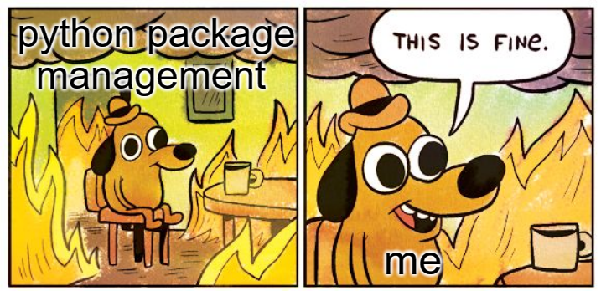
Coding Environment
Recommnedation: Python 3.9 or higher
Tips
We recommend you to use virtual environments when implementing your homework assignments.
Here are some popular virtual environment management tools
Poetry
Conda
Virtualenv

Slide 5
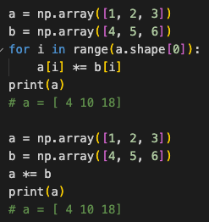
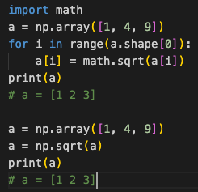
Numpy
High efficient vector and matrix operations
Numpy Tutorial: Link
element-wise multiply
squre root
Notes:
As previously mentioned, you will be implementing linear regression using only NumPy. NumPy is a powerful Python library that supports a wide range of array operations. We recommend that you have a basic understanding of NumPy before getting started. For instance, when performing element-wise multiplication, avoid writing code like this and instead utilize NumPy's multiplication function. Similarly, if you need to calculate element-wise square roots, there's no need to use the math library; simply use NumPy's numpy.sqrt() function.

Slide 6
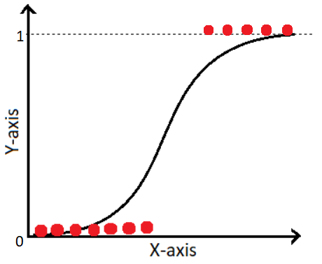
Logistic Regression for Binary classification
Find the best value of the weights and the intercept of a logistic model
label
Notes:
In the course, you learned about logistic regression, which is the process of finding the optimal values for the weights and the intercept of a logistic model to predict the probability of an event.

Slide 7
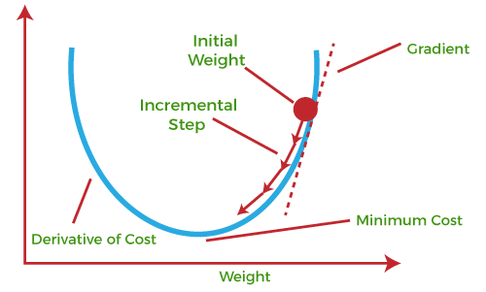
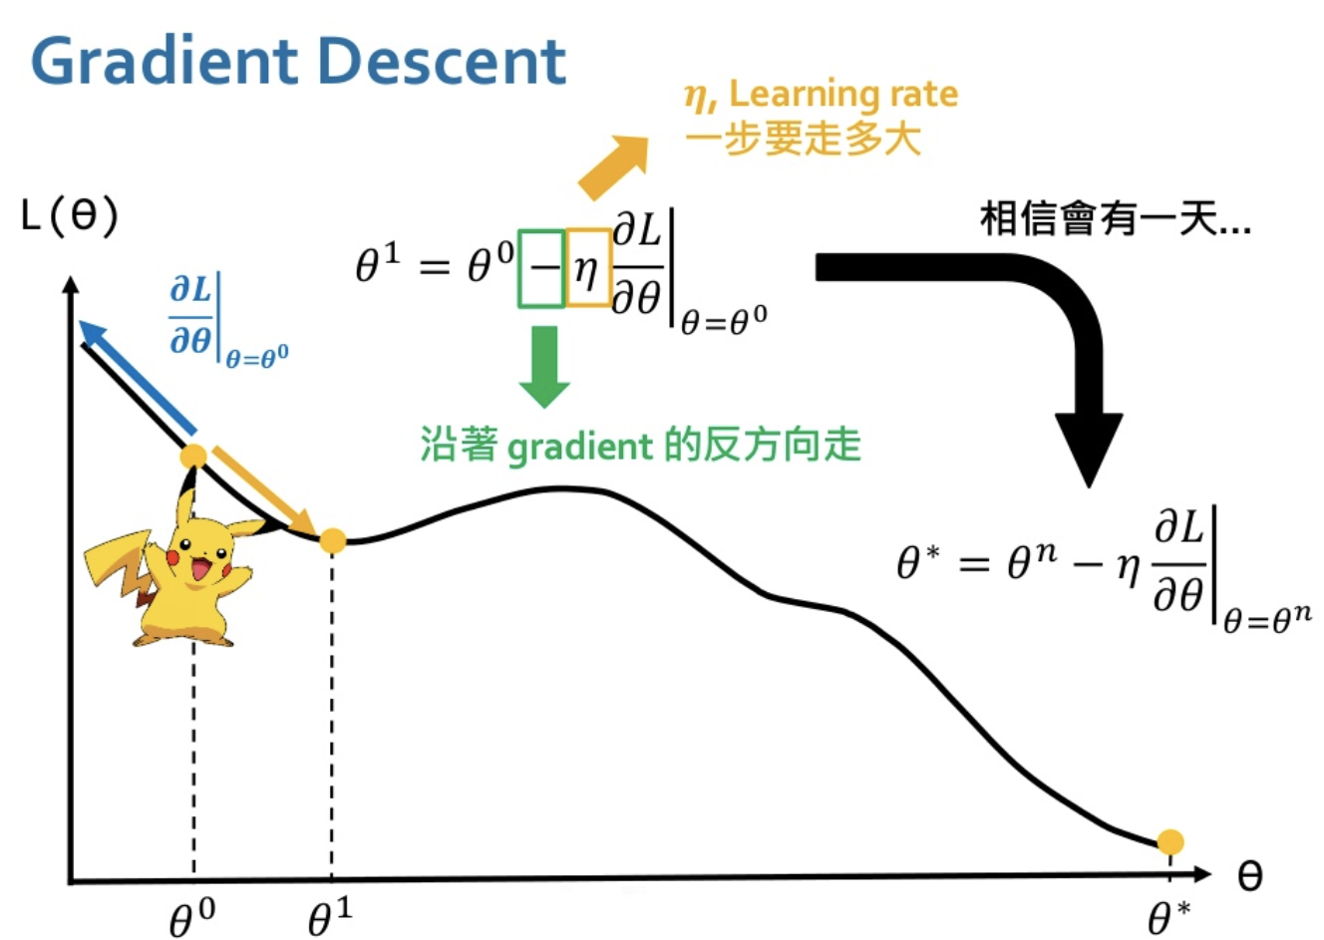
Logistic Regression
Gradient Descent
Learning rate: How far for one step
Move in the opposite direction of the gradient
To better understand GD, see https://www.youtube.com/watch?v=yKKNr-QKz2Q
Notes:
Therefore, the another approach is utilizing gradient descent to solve linear regression.

Slide 8
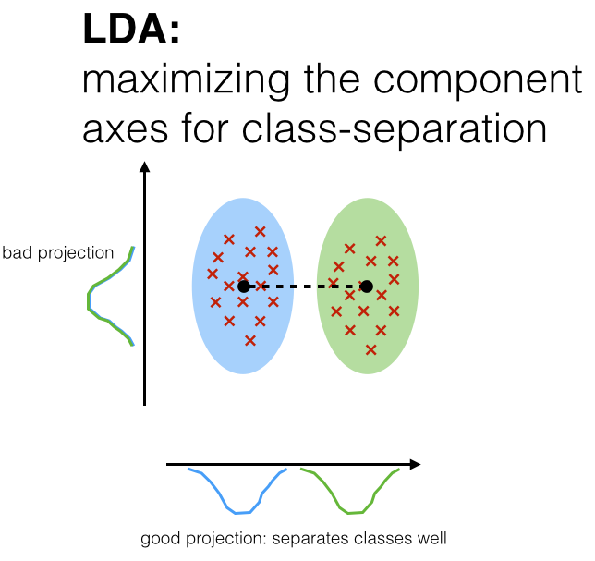
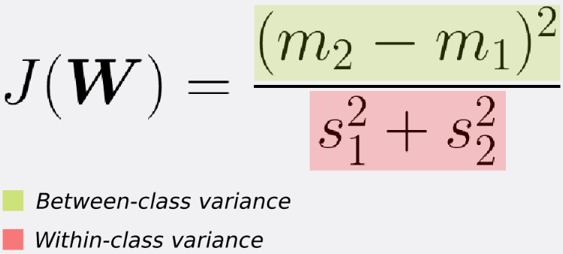
Fisher’s Linear Discriminant, FLD
FLD seeks the projection w that gives a large distance between the projected data center (means) while giving a small variance within each class.
https://sebastianraschka.com/Articles/2014_python_lda.html, https://sthalles.github.io/fisher-linear-discriminant/
Notes:
The second part is Fisher’s Linear Discriminant.
In the course, you learned about Fisher’s Linear Discriminant, which seeks the projection w that gives a large distance between the projected data means while giving a small variance within each class.

Slide 9
Dataset and Environment
Sonar dataset - A binary classification problem
Datapoints
208 (166 for train / 42 for test)
Features
60 features (already normalized)
Target
Rock or Mine (0 / 1)
Required packages: `numpy`, `pandas`, `matplotlib`, `loguru`, `flake8`, `pytest`, `scikit-learn`

Slide 10
Logistic Regression (25%)
Requirements
Use Gradient Descent to update your model.
Use CE (Cross-Entropy) as your loss function.
Grading Criteria
(0%) Show the hyperparameters (learning rate and iteration, etc) that you used. (-3 pts if absent)
(5%) Show your weights and intercept of your model.
(5%) Show the AUC score of the classification results on the testing set.
sklearn is allowed to compute AUC score (only for this)
(15%) Show the accuracy score of your model on the testing set.
Accuracy | Score (pt)
>=0.8 | 15 pt
>=0.75, <0.8 | 10 pt
>=0.7, <0.75 | 5 pt
<0.7 | 0 pt
Notes:
Your first task is to implement linear regression using the closed-form solution.You must display the calculated weights and intercepts for your linear model. It's important to note that there is a single correct solution for this task.
Here's a helpful tip: To validate the correctness of your implementation, you can cross-check your results using third-party libraries like scikit-learn.

Slide 11
Fisher’s Linear Discriminant, FLD (25%)
Requirements:
Implement FLD to project the data from 2-dimensional to 1-dimensional space.
Criteria:
(0%) Show the mean vectors m_{i} (i=0, 1) of each class of the training set. (-3 pts if absent)
(5%) Show the within-class scatter matrix S_{W} and between-class scatter matrix S_{B}of the training set.
(5%) Show the Fisher’s linear discriminant w of the training set.
Notes:
For logistic Fisher’s Linear Discriminant, Implement FLD to reduce the dimension of the data from 2-dimensional to 1-dimensional.
You have to show the mean vectors of the two classes, the within-class scatter matrix SW, the between-class scatter matrix SB and finally the Fisher’s linear discriminant w.
After that, you have to obtain the predictions for the testing data by measuring the distance between the projected value of the testing data and the projected means of the training data for the two classes. Finally, you have to show the accuracy score of your model.

Slide 12
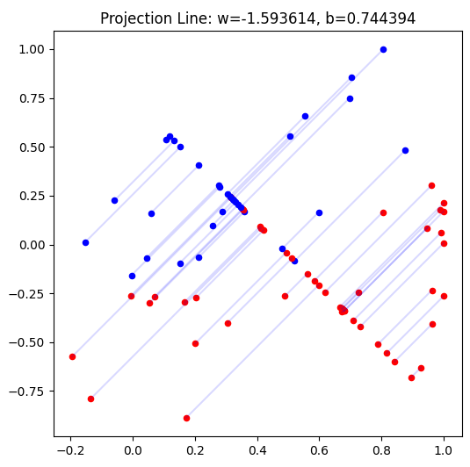
Fisher’s Linear Discriminant
Accuracy | Score (pt)
>=0.70 | 10 pt
>=0.6, <0.7 | 5 pt
<0.6 | 0 pt
Criteria
(15%) Obtain predictions for the testing set by measuring the distance between the projected value of the testing data and the projected means of the training data for the two classes.
Plot the projection line trained on the training set and show the slope and intercept on the title.
Obtain the prediction of the testing set, plot and colorize them based on the prediction.
Project all testing data points onto 1d space.
Also, Show the accuracy score on the testing set.
Just an example

Slide 13
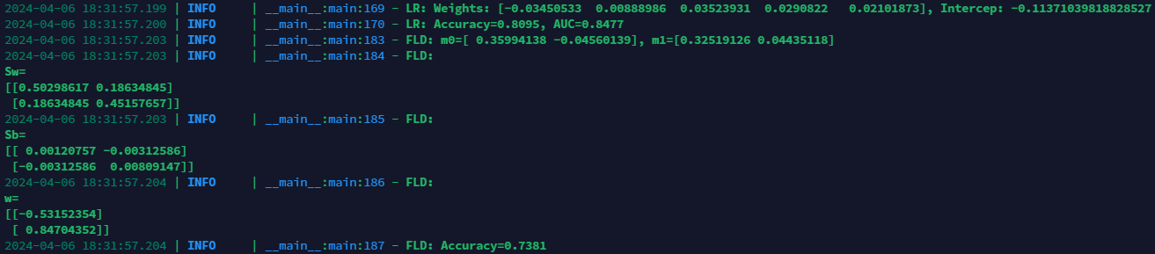
Code Output
Do not modify the main function architecture heavily.
Your code output will look like this
Notes:
We have already finished the main function, do not modify it and your code output will look like this.

Slide 14

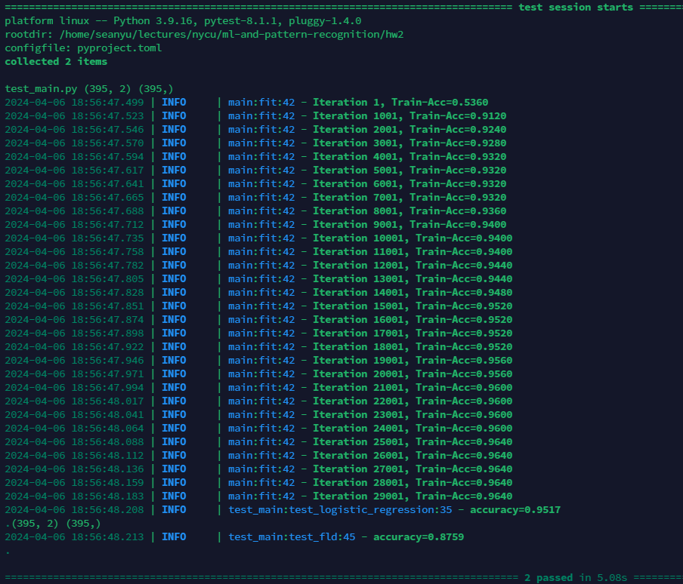
Additional Requirements
Python Coding Style Guide Reference
PEP8
Google Python Style
Code Check and Verification: Lint the code and show the PyTest results (10%)
Code linting:
-2pt per warning / error
Run PyTest:
-5pt per failed case
$ flake8 main.py
$ pytest ./test_main.py -s

Slide 15
Handwritten Questions (40%)
2-1 (10%)
Is it suitable to use Mean Square Error (MSE) as the loss function for Logistic Regression? Please explain in detail.
2-2 (15%)
In page 31 of the lecture material (linear_classification.pdf), we introduce two methods for performing classification tasks using Fisher's linear discriminator: 1) Determining a threshold, 2) Using the k-NN (k-nearest neighbors) rule.
Please discuss at least three aspects, either advantages or disadvantages, of using the k-NN method compared to determining a threshold (resources, performance, etc.).
2-3 (15%)
In logistic regression, what is the relationship between the sigmoid function and the softmax function? In what scenarios will the two functions be used respectively?

Slide 16
Report
Please follow the report template format. (-5pts if not use the template)
Link
Notes:
About the report, please follow the report template format.

Slide 17
Submission
Compress your code and report into a .zip file and submit it to E3.
Report should be written in English. (-5 pts if not English)
<STUDENT ID>_HW2.zip
main.py
setup.cfg
test_main.py
<STUDENT ID>_HW2.pdf (NO .doc, .docx or others format)
Don’t put the data (e.g. train.csv / test.csv) into submission file
Notes:
About submission, you have to Compress your code and report into a .zip file and submit it on E3. You should name your files correctly.

Slide 18

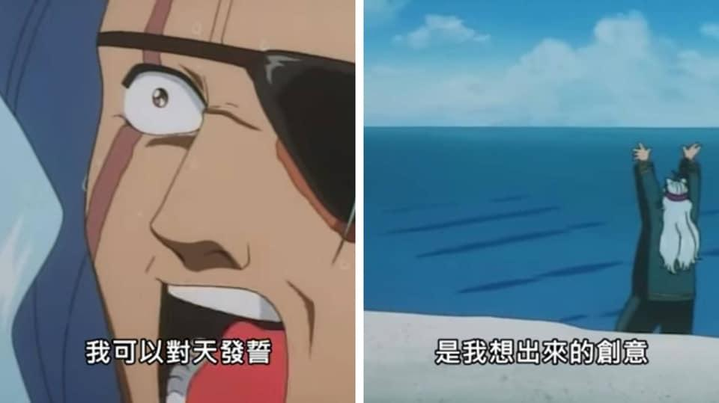
Other rules
Late Policy: A penalty of 20 points per additional late day. (-20pt / delayed.day)
For example, If you get 90 points but delay for two days, your will get only 50 points!
No Plagiarism: You should complete the assignment by yourself. Students engaged in plagiarism will be penalized heavily. Super serious penalty.
e.g. -100pt for the assignment or failed this course, etc
Report to academic integrity office

Slide 19

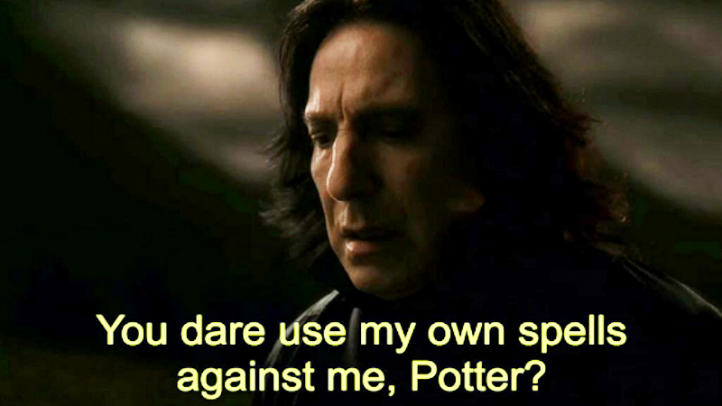
AI-Assistant
Not recommended but no forbidden
Copy-and-Paste answers from the AI-Assiant will be seen as Plagiarism
However, you can have your own answer first then rephrase it by AI-Assiant.
Some questions might be parts of final exam, make sure you understand the concept

Slide 20
FAQs
If you have other questions, ask on E3 forum first! We will reply as soon as possible.
If the E3 discussion area still have issues, feel free to write email to TAs (And remember to cc all TAs).

Slide 21
Have Fun!

